Slide 1

SCSS Basic
BIT Project Programme

Slide 2



What is Sass ?
Sass (short for syntactically awesome style sheets) is a preprocessor scripting language that is interpreted or compiled into Cascading Style Sheets (CSS).
Sass consists of two syntaxes.
“SASS” uses a syntax similar to Haml.[2] It uses indentation to separate code blocks and newline characters to separate rules. ( uses .sass extension )
"SCSS" (Sassy CSS), uses block formatting like that of CSS. It uses braces to denote code blocks and semicolons to separate rules within a block. ( uses .scss extension ) **SCSS syntax is used in the project. Because the similarity of syntaxes.
Just as type script, writing CSS on SCSS is accepted.
Both syntaxes are compiled by sass compiler.
test.scss
sass compiler
test.css

Slide 3
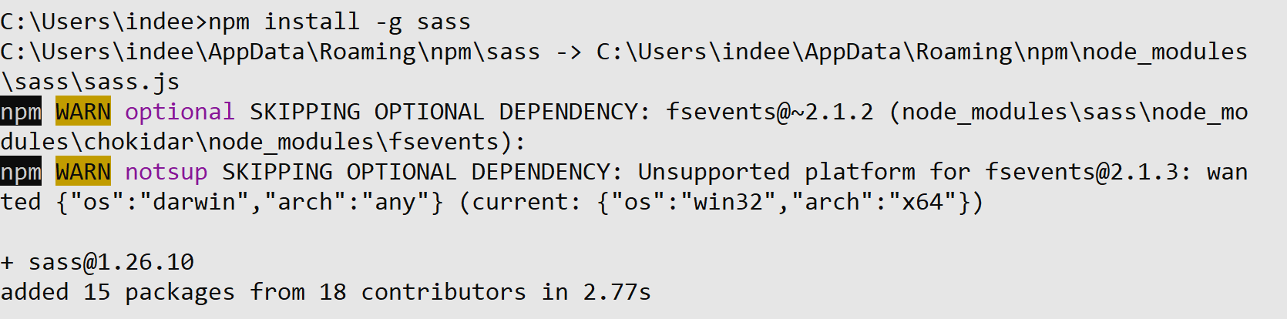
Installation of Sass Compiler
Type this command in command prompt to install SCSS.
npm install -g sass
Note : We are installing SASS compiler separately for testing purposes only. When we are installing angular SASS compiler is automatically installed.
Don’t use shell based command line client (windows PowerShell), use windows command prompt
If any error occurred type “npm cache clean --force” command

Slide 4
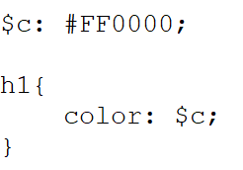
First SCSS File
Create a new folder as “sass” in your desktop or as you like.
Create a file as “test.scss” in that folder.
Open it using a text editor like “Sublime Text”
Write Below code,
Open Command Prompt and navigate to the “sass” folder.
Enter Below Command,
Now you can see a file as “test.css” in the “sass” folder.
Output file (compulsory)

Slide 5

First SCSS File(Cont.)
test.scss
Compile
test.css

Slide 6
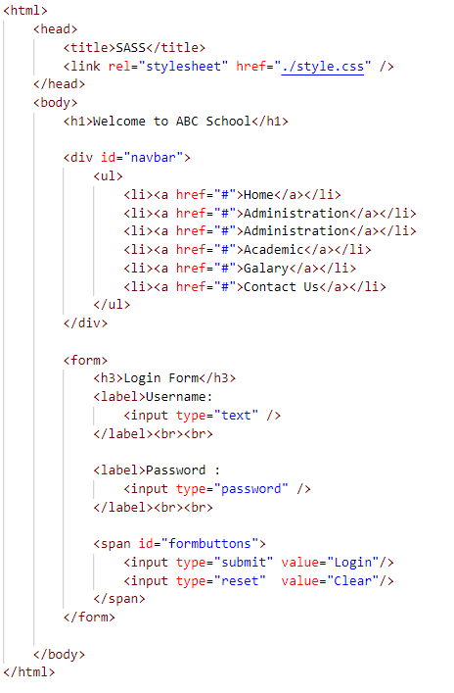
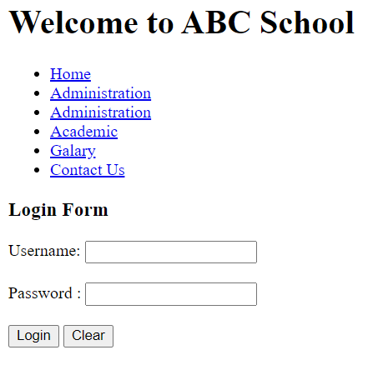
Variables
Create a file named “index.html”.
Write following codes in that file and open using a browser. (Note : css file is yet to be created.)

Slide 7
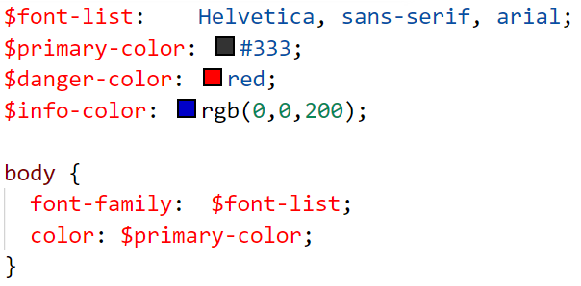
Variables (cont.)
Create a filed named “style.scss” file in the same directory as “index.html” file.
Open the scss file using a text editor and code the following snippet.
These are variables.
Variables are used to store information that you want to reuse throughout your stylesheet.
You can store things like colors, font stacks, or any CSS value you think you'll want to reuse.
Sass uses the $ symbol to make something a variable.
Selectors are same as CSS
style.scss

Slide 8
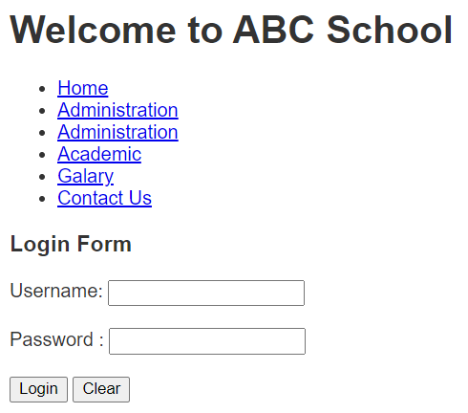
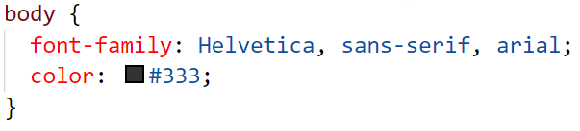
Variables (cont.)
Compile the scss file and generate css file.
Refresh the browser and observe.
style.css

Slide 9
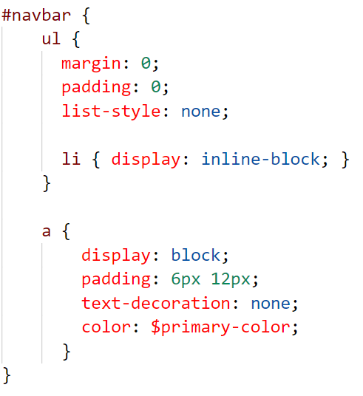
Nesting
When writing HTML you've probably noticed that it has a clear nested and visual hierarchy. CSS, on the other hand, doesn't.
Sass will let you nest your CSS selectors in a way that follows the same visual hierarchy of your HTML.
Code the following snippet in the scss file.
ul is inside of #navbar (id selector)
li is inside of ul
Important : Overly nested rules will result in over-qualified CSS that could prove hard to maintain and is generally considered bad practice
style.scss

Slide 10
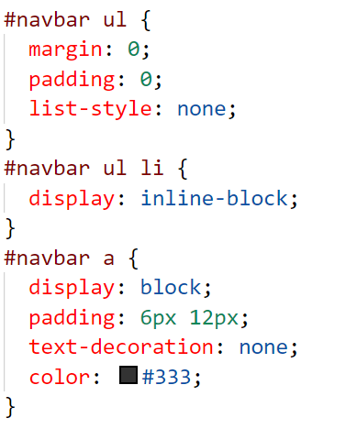
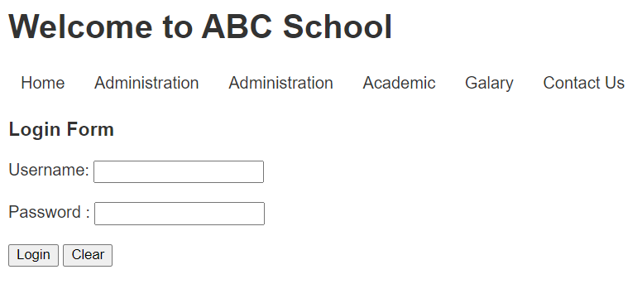
Nesting (cont.)
Compile the scss file.
Observe the css file and the browser output.
style.css

Slide 11
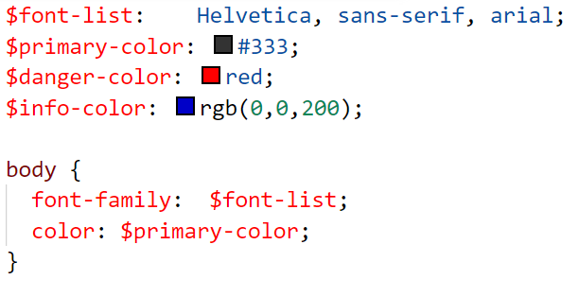
Modules
You don't have to write all your Sass in a single file.
You can split it up however you want with the @use rule.
This rule loads another Sass file as a module, which means you can refer to its variables in your Sass file with the filename. Using a file will also include the CSS it generates in your compiled output!
Create a file called “base.scss ” and move following code from style.scss.
base.scss

Slide 12
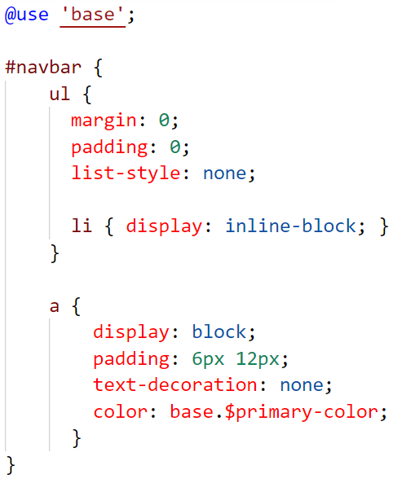
Modules (cont.)
Modify style.scss file as below.
@use is used to import another scss file.
style.scss
When using variables from another scss file the name of the file must be used. Otherwise it will generate errors

Slide 13
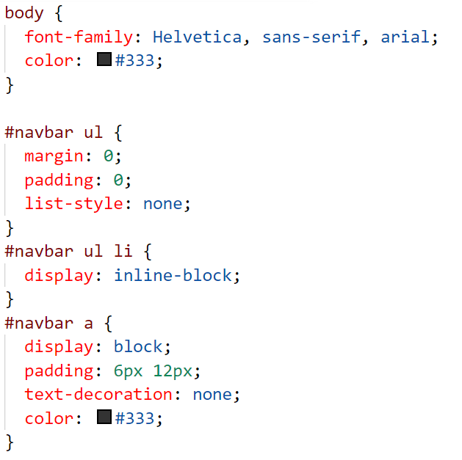
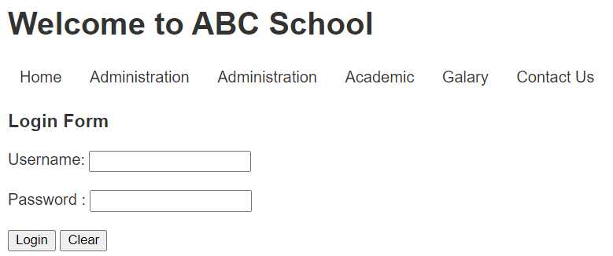
Modules (cont.)
Compile “style.scss” file.
Observe that only one css file has generated and content is same as before.

Slide 14
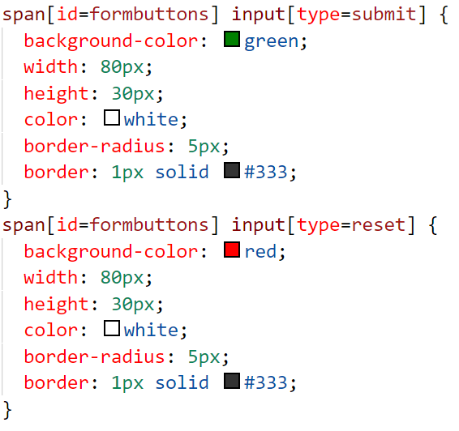
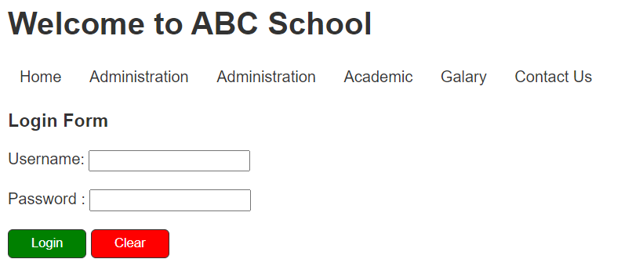
Mixins
Mixins allow you to define styles that can be re-used throughout your stylesheet.
Look at the example below,
Both buttons has almost same attributes as text color, size, border.
If someone manually code this it would look like this. It has boilerplate code.
In this type of scenario mixins can be used.

Slide 15
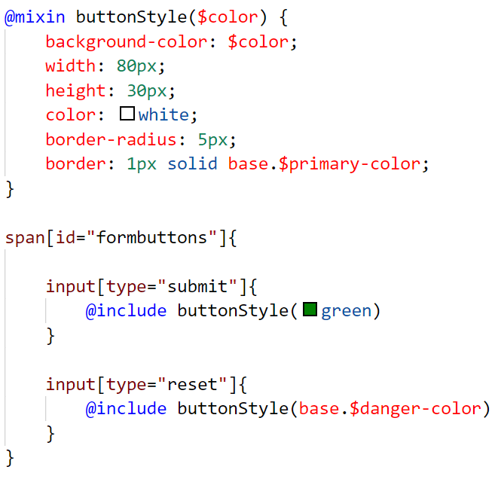
Mixins (cont.)
Insert this code to style.scss file.
Specific color is passed when applying a mixin. To call a mixin @include is used.
Compile and observe.

Slide 16
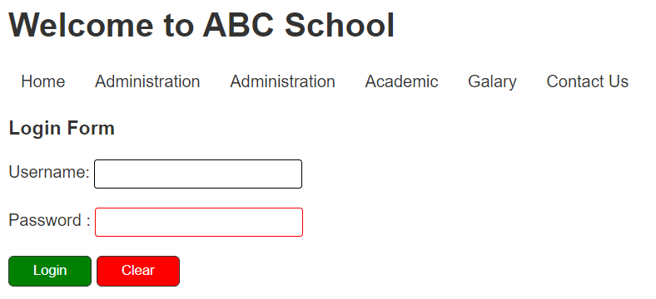
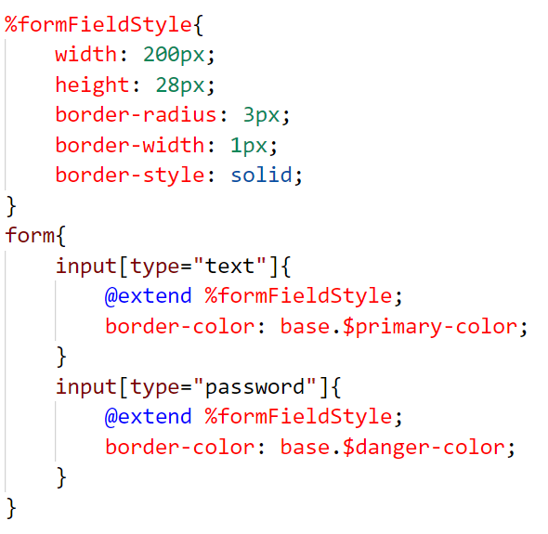
Extend / Inheritance
This is just like mixins. Difference is you cannot pass arguments when calling.
Both input fields have same attributes otherwise boarder color.
Code the following code snippet inside of style.scss and compile. Observe css file.

Slide 17
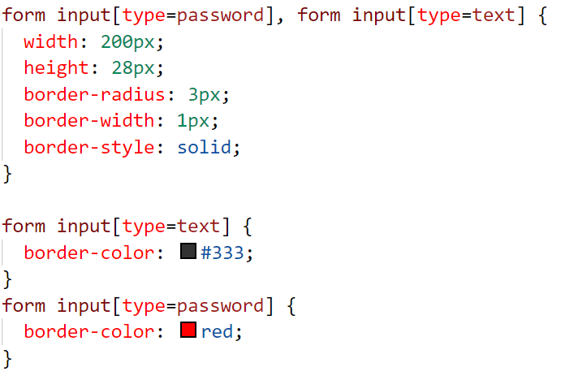
Extend / Inheritance (cont.)
CSS file look like this.

